Slide 1

Unit 12

Slide 2
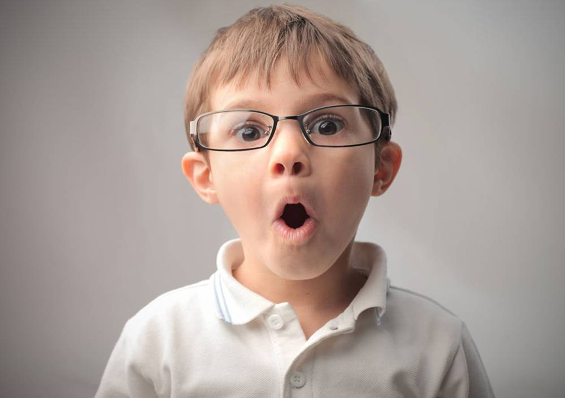
Unit 12
Life is full of the unexpected.

Slide 3



Slide 4


根据句意及括号内所给词的提示填空。 1. Dennis ____________(study) English for four years before he went to the USA. 2. Wu Dong’s parents ___________(not have) any news about him for three months until he ________(call) them yesterday.
had studied
hadn’t had
called

Slide 5
3. Henry _____________(collect) more than 100 foreign stamps before he ________(join) the stamp collecting club last year. 4. By the time I ______(get) home, my father ________(leave) for New York. 5. I ________________(memorize) 900 English words when I ________(be) ten. 6. He _______(say) that he ____________ ________ (learn) some French before.
had collected
joined
got
had left
had memorized
was
said
had learnt /
learned

Slide 6


1. To understand Dave’s, Nick’s and Joe’s experiences on April Fool’s Day
2. To be able to tell April Fool’s Day stories

Slide 7


April Fool’s Day
n.蠢人；傻瓜
v.愚弄
Date: April 1
Origin: France
Activity:
* Play jokes
* Spread hoaxes

Slide 8
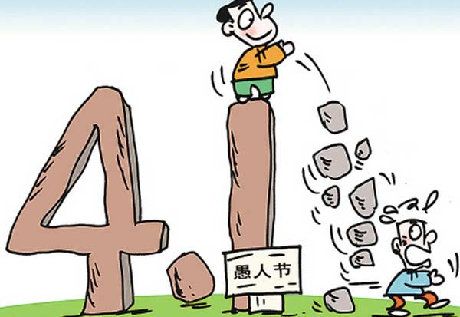
What did you do on April Fool’s Day?

Slide 9

Put these words in the correct columns in the chart. Some words can go in more than one column.
1a
fool invite
costume embarrassed
go off call
get dressed empty
show up realize
change clock
tired stay up
n. （特定场合穿的）服装；装束
adj. 窘迫的，害羞的

Slide 10
Nouns (people, place, things) | Verbs (action words) | Adjectives (description words)
fool invite
go off
get dressed
show up
realize change stay up
fool
costume
change
clock
embarrassed
tired
empty

Slide 11

Tell your partner about something
that happened to you recently. Use two or more words in 1a.
1b
Last Friday night, my friend invited me to his birthday party…

Slide 12

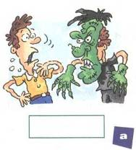
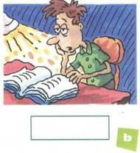
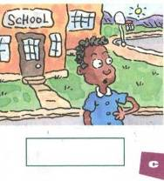
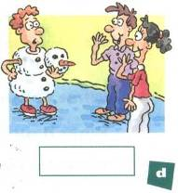
Dave, Nick and Joe are talking about April Fool’s Day. Listen and write each person’s name under the correct picture.
1c
Dave
Nick
Joe

Slide 13

Listen again. Who says each of the
phrases below? Write D for Dave,
N for Nick and J for Joe.
1d
1. ______ a costume party
2. ______ my alarm went off
3. ______ stayed up all night
4. ______ was tired
5. ______ was really embarrassed
6. ______ the other kids showed up
D
N
J
J
D
N

Slide 14
Listen again and complete the blanks.
Nick: Has someone ever tricked you on April Fool’s Day, Dave?
Dave: Yes. A friend once invited me to a______________. When I got there, I found that it wasn’t a costume party. I was the only person wearing a costume, and I was really ___________. How about you, Nick?
costume party
化装舞会
embarrassed

Slide 15
Nick: Well, last April Fool’s Day, when my alarm went off, I got up, took a shower, got dressed, and went to school. But when I got there, the school was empty. I was the only one there. After an hour, the other kids showed up, and I realized that my brother ___________ me.
Dave: He had?
had fooled

Slide 16
Nick: Uh-huh. He _____________ the clock to an hour earlier. What about you, Joe? What happened to you on April Fool’s Day?
Dave: Well, my friend called me on March 31st last year and told me we had a math test the next day. By the time I got to math class, I was _____ because I had stayed up all night studying. Then I found out that my friend had fooled me. We didn’t have a test at all!
had changed
tired

Slide 17
Group work
Tell April Fool’s Day stories in your group. Use the information in 1c and 1d.
1e
A: What happened to Dave on April Fool’s Day?
B: Well, a friend invited him to a costume party …

Slide 18


1. Dave, Nick and Joe are talking about April Fool’s Day.
fool n. 傻瓜；愚人；受骗者
vt. 愚弄，欺骗；
e.g. He was fooled by his friend on April Fool’s Day.
愚人节那天他被他的朋友愚弄了。

Slide 19
________是fool的形容词形式，愚蠢的；傻的。
e.g. She’s just a vain, foolish woman.
她不过是个愚蠢虚荣的女人。
foolish

Slide 20
2. Dave was really embarrassed.
embarrassed adj. 局促不安的；为难的；
尴尬的；窘迫的
embarrassing adj. 使人尴尬的，
令人为难的
e.g. He looked a bit ______________.
他看起来有点尴尬。
That was an ______________
situation for me.
那种情形让我难堪。
embarrassed
embarrassing

Slide 21
3. The other kids showed up.
show up 露面，到场；（使）看得见
e.g. We waited until five o’clock, but he
did not show up.
我们一直等到了5点，但是他始终没
有露面。

Slide 22


get dressed
costume party
stay up all night
April Fool’s Day
穿上衣服
化装舞会
整晚熬夜
愚人节
句型
What happened to Dave on April Fool’s Day?

Slide 23


Ⅰ. 根据句意及括号内所给单词的提示填空。
1. You are playing outside in such hot weather. You are all _______(fool).
2. Judy was so ____________(embarrass) by all the praise — her face went red.
fools
embarrassed

Slide 24
Ⅱ. 根据汉语意思完成英语句子。
1. —Do you think it’s a good idea to ______
(熬夜) for the football match?
—In fact, I do. After all, it's the final of the World Cup.
2. John jumped out of bed and ______________ (穿衣服) as quickly as he could, and then rushed to work.
stay up
got dressed

Slide 25


Write a short passage about something that happened to you recently. Here is an example for you.

Slide 26
Last Friday night, my friends invited me to the costume party. At 6:00 p.m., I got dressed and went off to take bus. I showed up a little late because of the traffic jam. The party was really interesting and I enjoyed myself.

Slide 27


